Slide 1

Study Visit 2.0
Working with your own raw data
Copenhagen *INDSÆT DATO*

Slide 2
Outline
1: Where Is Everything
2: Data Flow
3: About GamsPy
4: Common errors and how to fix them
5: Ressources for debugging

Slide 3
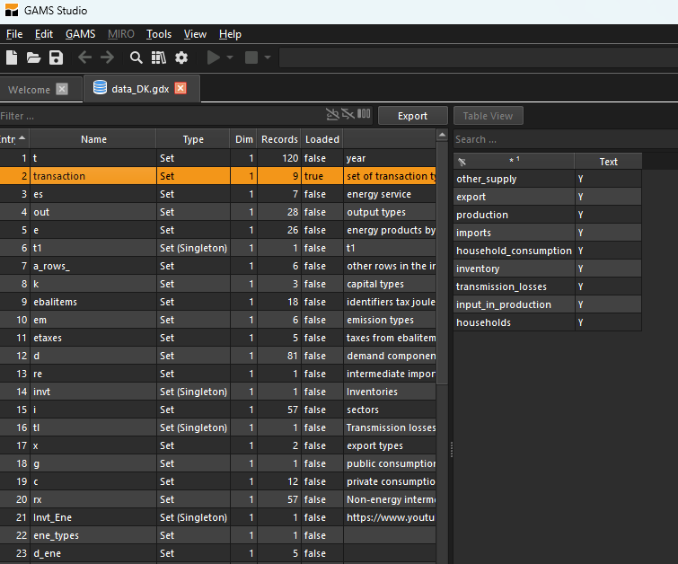
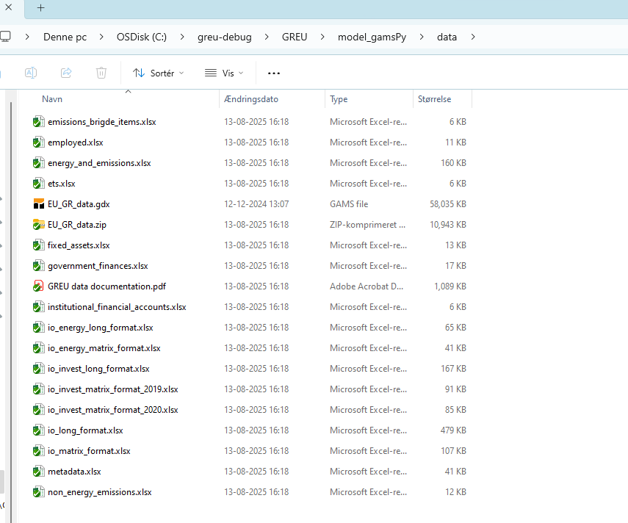
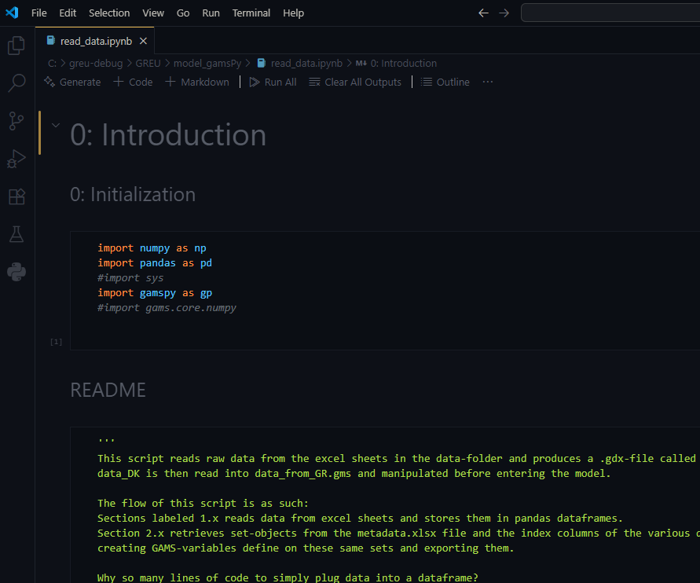
Where is everything..
..\GREU\model_gamsPy\read_data.ipynb
..\GREU\model_gamsPy\data
..\GREU\data\data_DK.gdx

Slide 4



Data flow
Data
manipulation
Gams data transfer
Pandas
Python
GamsPy
.gdx
Model
Raw data

Slide 5
The GAMS Python API
Container
Container: the mother structure
Sets: Collections of
different things
Variables/parametres:
Functions that associate
set-elements with numbers
GAMS-objects
Sets
Real numbers
Variables
/parametres

Slide 6
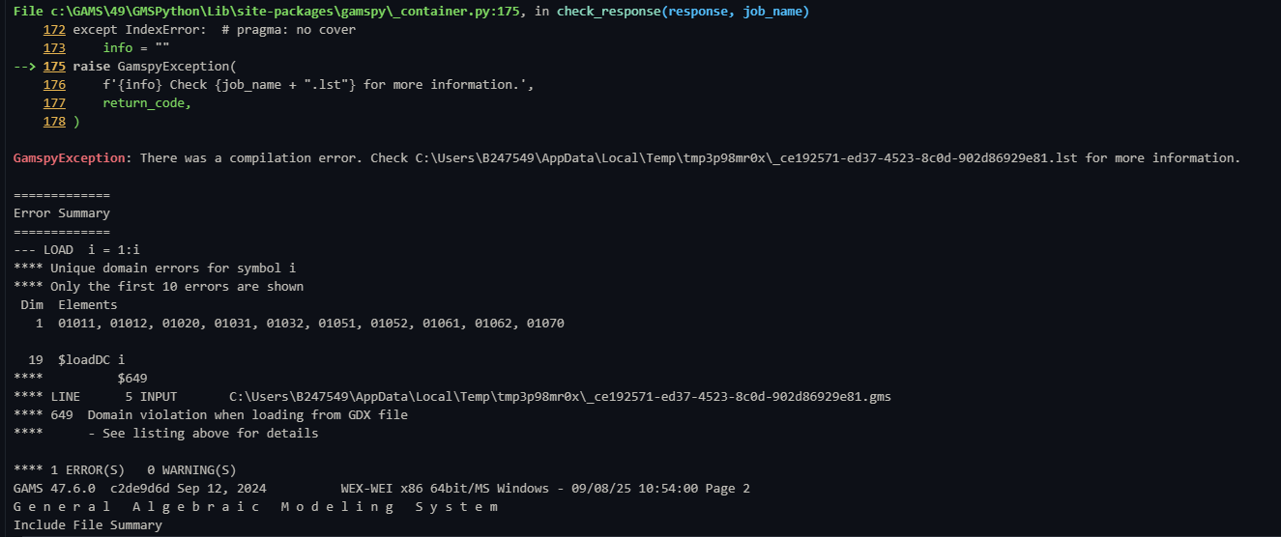

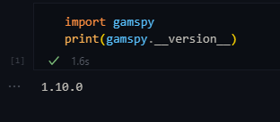
Common errors
Domain violation I: Nor properly populating a set
Domain violation II: Strings vs. Integers vs. Float vs. NaN
Set-hierarchies
Hard-coding…
Check your version of gamspy

Slide 7
Understanding non-trivial common errors
Error type I: Element missing
Error type II: Non-uniqueness of elements
Domain violation I: Not properly populating a set:
A set may be populated from metadata.xlsx
Columns in a dataframe
Hard-coded
Gives us an authoritative list to check values against
”Centralizes” the set
Safe for the particular dataframe
Requires object defined by dataframe to be ”big enough”
Mistakes can be hard to spot

Slide 8
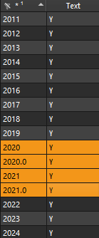

Understanding non-trivial common errors II:
Domain violation II: Strings vs. Integers vs. Float vs. NaN
Why does this happen?
Can cause ”invisible” errors
Easy to fix.. Just convert datatype and
drop duplicates

Slide 9
Understanding non-trivial common errors III
In GAMSPy, define parametres and variables on the largest possible set
Set hierarchies
Sets are collections of things, a set that shares all of its elements with another set is called a subset
We can explicitly tell GAMS to only operate on subsets
When populating a set – if it is a subset, make sure elements are also in the parent set

Slide 10
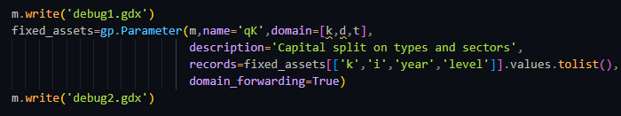
Ressources
Gamspy is documented: GAMSPy documentation
Danish .gdx file
Domain_forwarding=True
Trial: ..\GREU\model_gamsPy\data_reading trial
Debug: use ”m.write(‘test.gdx’)” immediately before the line which causes error
This website or That website
Exercises (solutions): karlnoergaard/GREUDataExercises: Some exercises
Call

